Slide 1
Improving code quality with Roslyn Analyzers
https://github.com/jwooley/Analyzers
https://github.com/jwooley/RoslynLabs

Slide 2




About Jim
Solultion Architect
Microsoft MVP
Slalom Consulting
Visual Studio Tools
03
Author
@JimWooley
LINQ in Action
https://jwooley.github.io
https://github.com/jwooley/Analyzers
http://www.thinqlinq.com
Notes:
Click the icon and navigate to your photo on your computer
Crop and position photo as desired
Go to the Arrange drop down menu > choose “send to back” to reveal text

Slide 3
Code Quality
Compile
Unit Test
Static Analysis
Peer Reviews
Trend Analysis
CI/CD
Style Guide

Slide 4
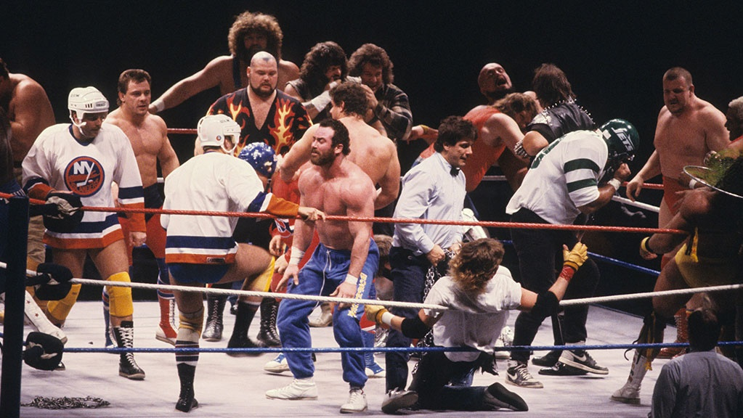

Slide 5

Interchangable team members

Slide 6


Slide 7
Code Quality
Compile
Unit Test
Static Analysis
Peer Reviews
Trend Analysis
CI/CD
Style Guide

Slide 8

“Static program analysis is the analysis of computer software that is performed without actually executing programs.”
Wikipedia
https://en.wikipedia.org/wiki/Static_program_analysis
slalom.com
Notes:
Quote Sample

Slide 9
Why use
Standardize within team
Improve maintainability
Allow code review to focus on domain/logic issues
Detect common errors not caught by compiler
Fix code smells

Slide 10
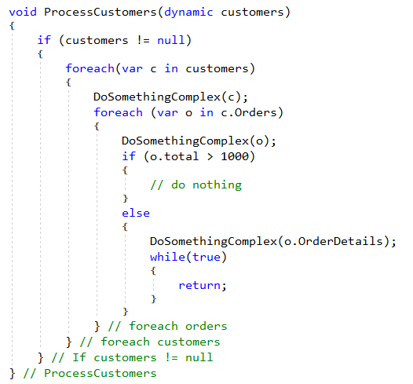
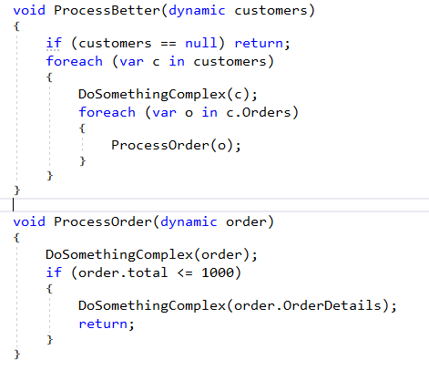
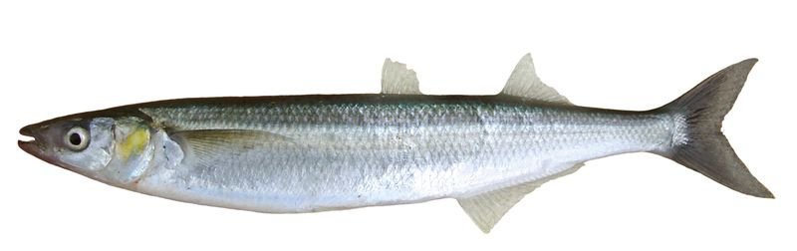
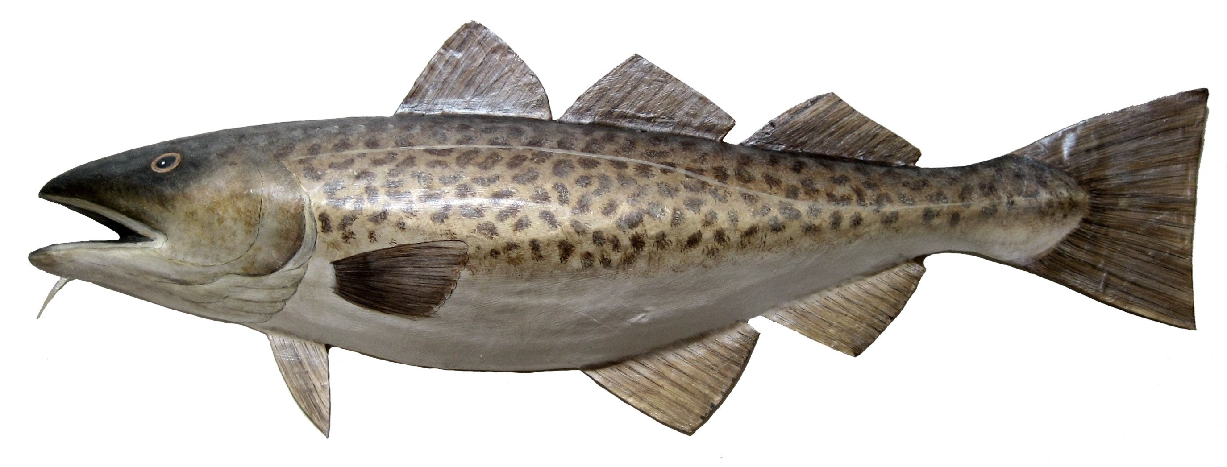

Fixing Cod Smelts
e
^
l

Slide 11
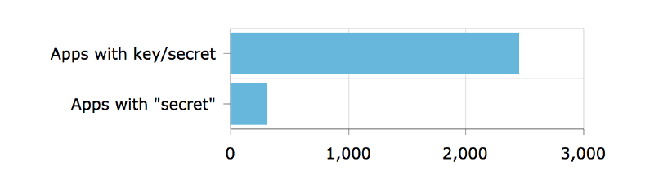
Detect security vulnerabilities
Out of 16,000 apps — apps with keys or secrets
https://hackernoon.com/we-reverse-engineered-16k-apps-heres-what-we-found-51bdf3b456bb#.eechvyizf

Slide 12
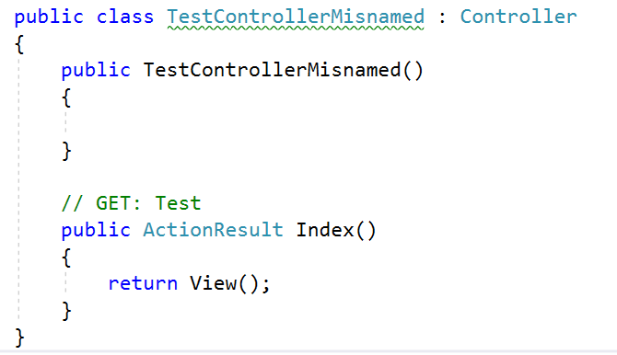
Detect domain specific errors

Slide 13

Recommend best practices

Slide 14
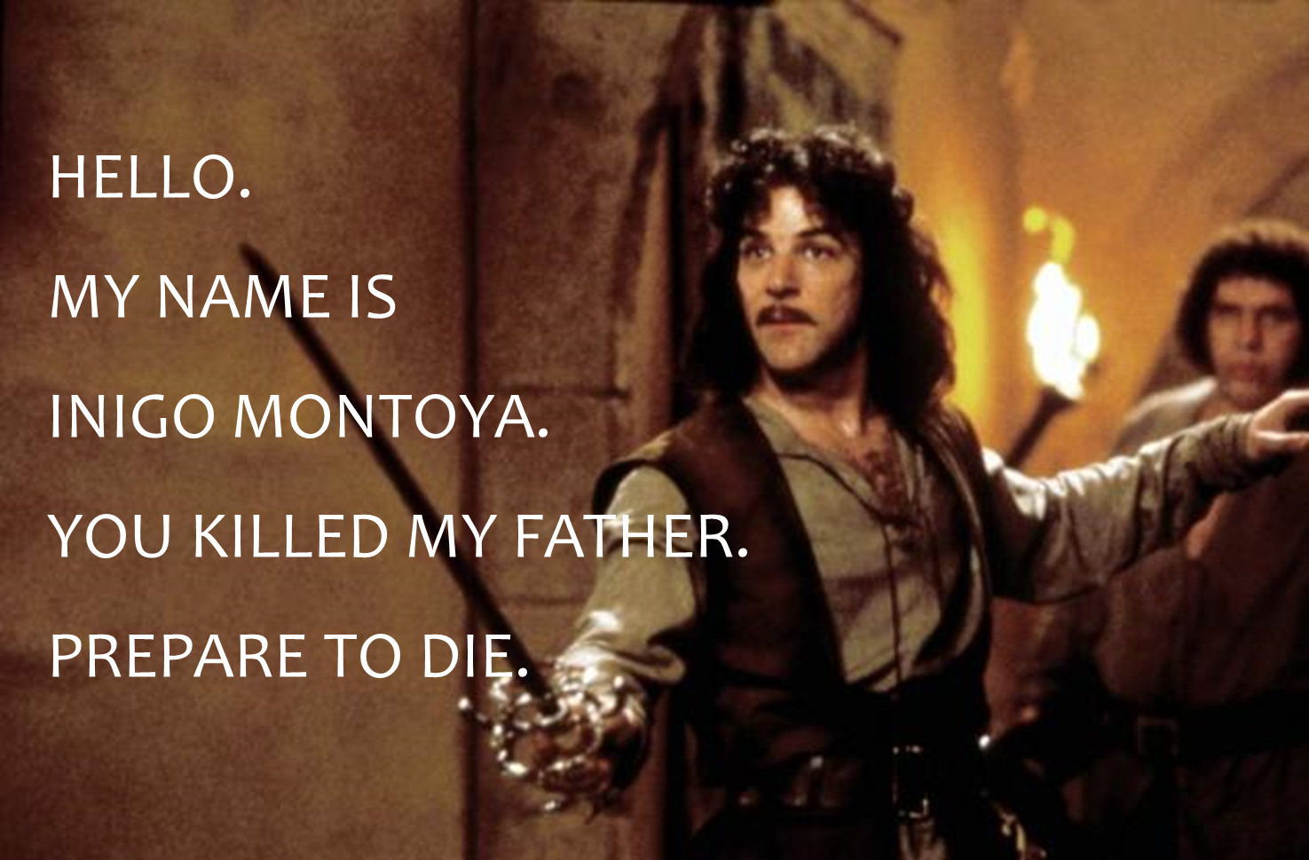
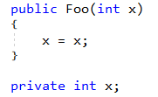
Names matter

Slide 15
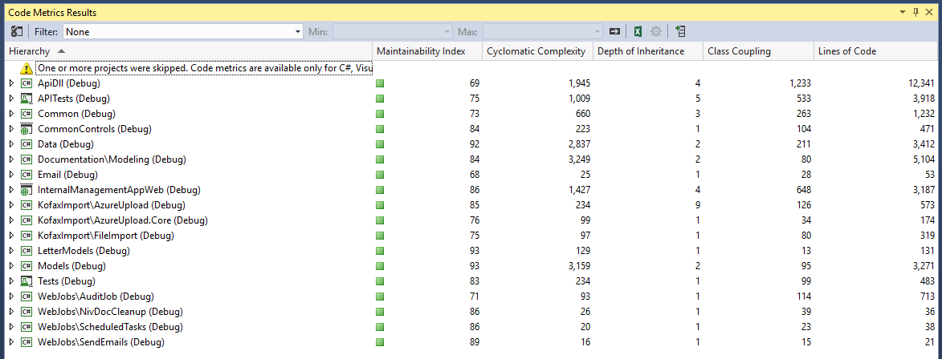
Detect maintainability issues

Slide 16
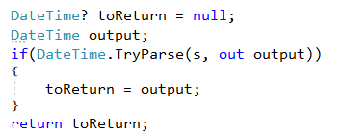
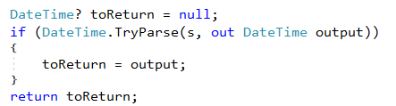
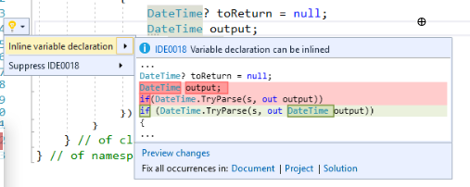
Recommend modernized syntax
Notes:
Click the icon and navigate to your photo on your computer
Crop and position photo as desired
Go to the Arrange drop down menu > choose “send to back” to reveal text

Slide 17
Demo
Using Visual Studio built in analyzers

Slide 18
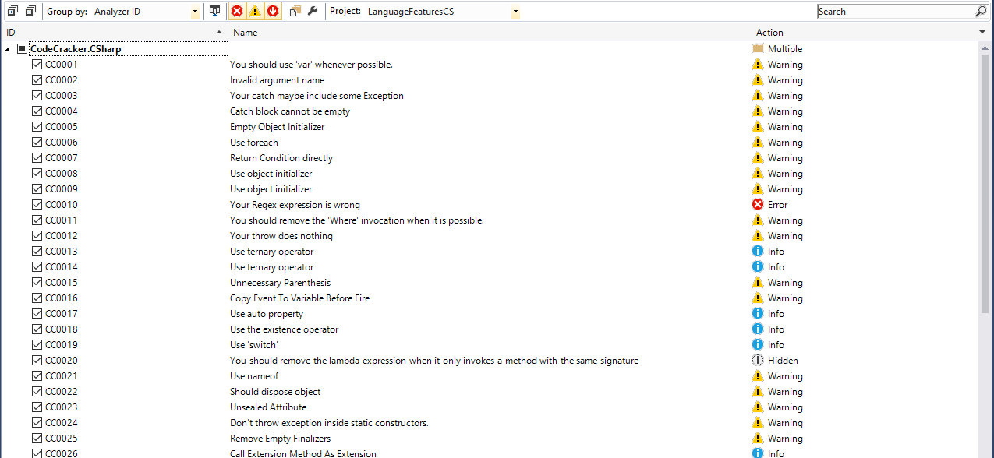
Extensible and Customizable

Slide 19
.editorconfig
[*]
end_of_line = crlf
[*.{cs,py,xmlm}]
indent_style = tab
[*.{js}]
indent_style = space
indent_size = 2
[*.cs]
dotnet_style_qualification_for_field = false:suggestion
dotnet_style_qualification_for_property = false:suggestion
dotnet_style_qualification_for_method = false:suggestion
dotnet_style_qualification_for_event = false:suggestion
dotnet_style_predefined_type_for_locals_parameters_members = true:suggestion
dotnet_style_predefined_type_for_member_access = true:suggestion
dotnet_style_object_initializer = true:suggestion
dotnet_style_collection_initializer = true:suggestion
dotnet_style_explicit_tuple_names = true:suggestion
dotnet_style_coalesce_expression = true:suggestion
dotnet_style_null_propagation = true:suggestion
csharp_style_var_for_built_in_types = true:suggestion
https://docs.microsoft.com/en-us/visualstudio/ide/editorconfig-code-style-settings-reference

Slide 20
Lab 1 -
Using Visual Studio built in analyzers
https://github.com/jwooley/RoslynLabs
https://docs.microsoft.com/en-us/visualstudio/ide/create-portable-custom-editor-options
https://docs.microsoft.com/en-us/visualstudio/ide/editorconfig-naming-conventions

Slide 21
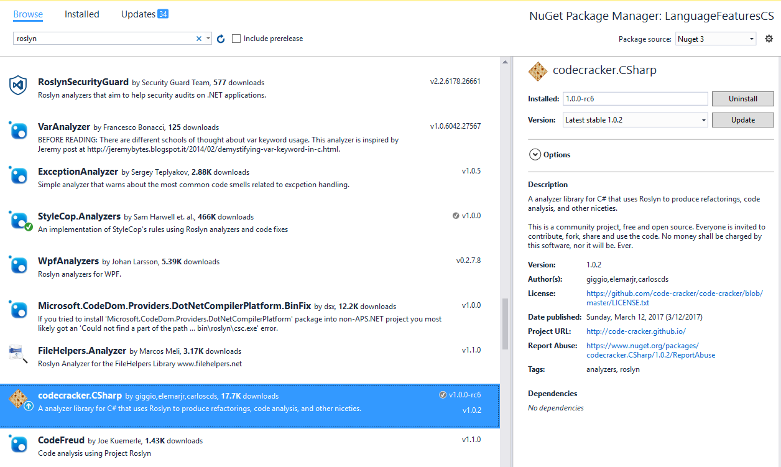
Adding Analyzer from Nuget

Slide 22
Demo
Using third party analyzers

Slide 23
Lab - 2
Using third party analyzers
https://github.com/jwooley/RoslynLabs

Slide 24
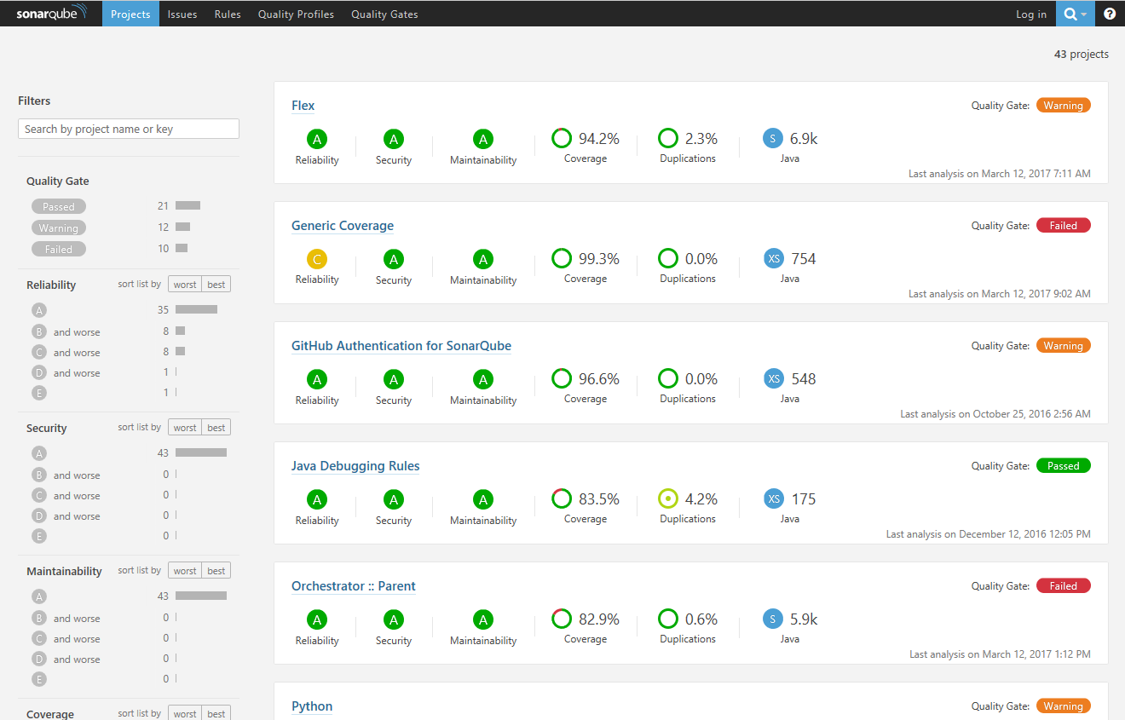
SonarQube

Slide 25
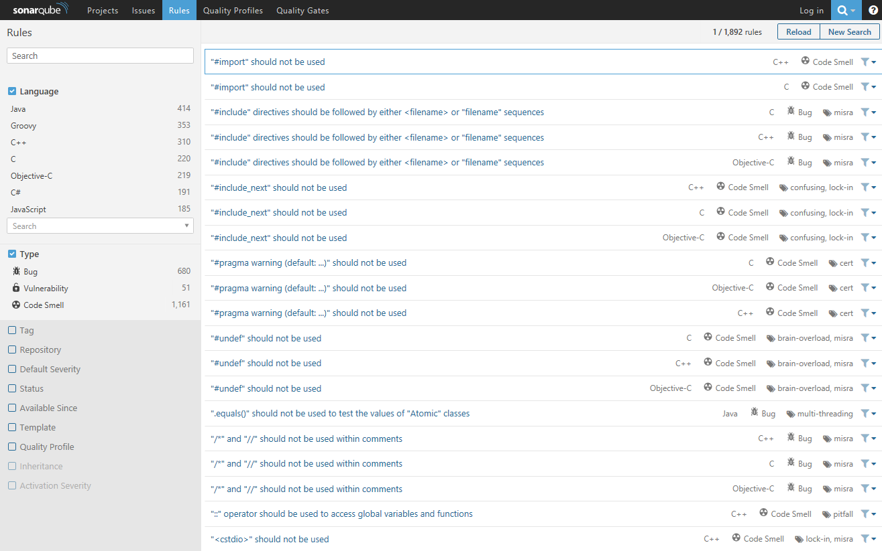
Sonar Rules

Slide 26
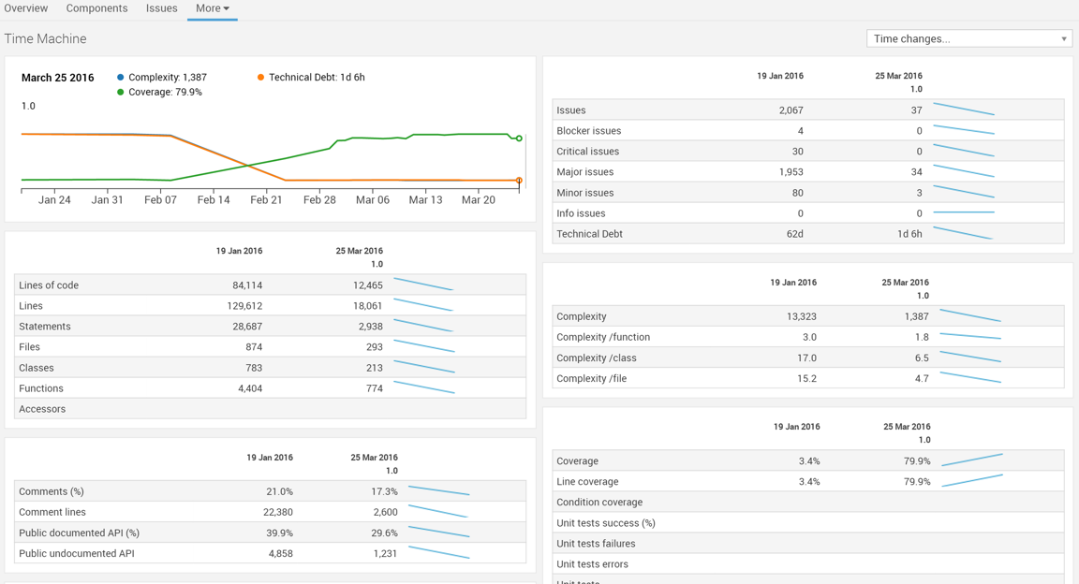
Sonar improvements

Slide 27
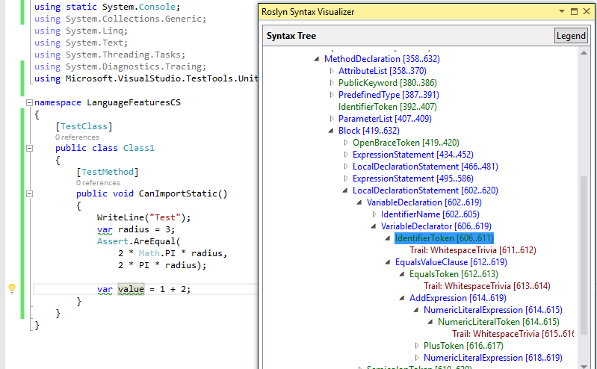
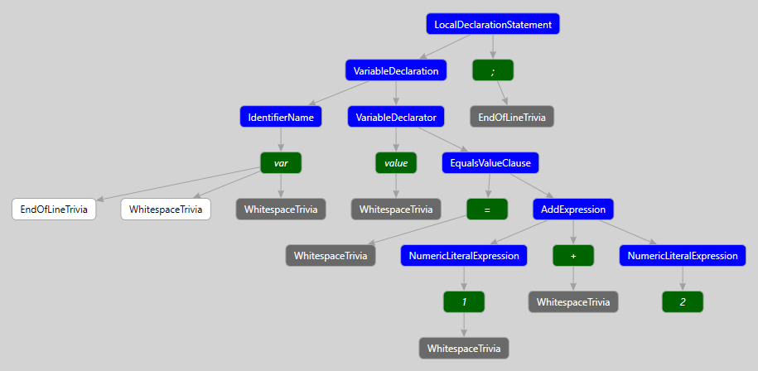
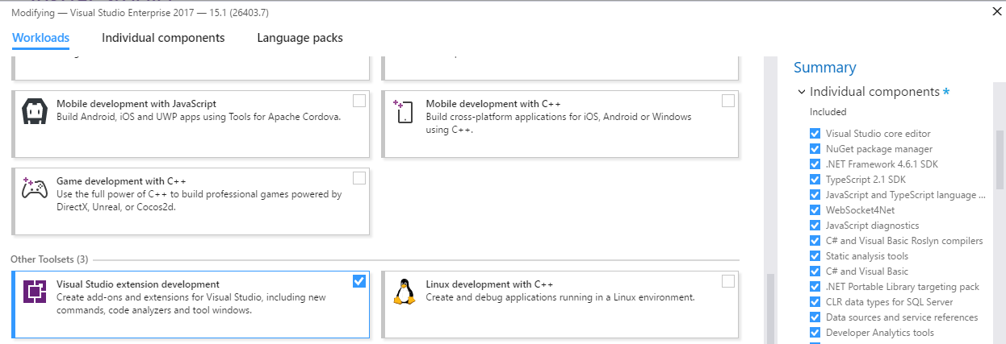
Building your own Fix
ExpressionSyntax
SyntaxToken
SyntaxTrivia
var value = 1 + 2;
var equalsValue =
SyntaxFactory.EqualsValueClause(
SyntaxFactory.BinaryExpression(
SyntaxKind.AddExpression,
SyntaxFactory.LiteralExpression(
SyntaxKind.NumericLiteralExpression, SyntaxFactory.Literal(1)),
SyntaxFactory.LiteralExpression(
SyntaxKind.NumericLiteralExpression,SyntaxFactory.Literal(2))
));
var typeSyntax =
SyntaxFactory.VariableDeclaration(
SyntaxFactory.ParseTypeName("var"),
new SeparatedSyntaxList<VariableDeclaratorSyntax>()
.Add(SyntaxFactory.VariableDeclarator(“value")
.WithInitializer(equalsValue)))
.NormalizeWhitespace(" ")
.WithAdditionalAnnotations(Formatter.Annotation);
var declaration = SyntaxFactory.LocalDeclarationStatement(typeSyntax);
http://roslynquoter.azurewebsites.net/

Slide 28
Detect domain specific errors

Slide 29
Creating your own Roslyn analyzer and Code Fix
[DiagnosticAnalyzer(LanguageNames.CSharp)]
public class WebApiControllerNamingConventionAnalyzer : DiagnosticAnalyzer
{
string DiagnosticId = “WA0001";
string Description = "Controller type should end in 'Controller'";
string MessageFormat = "Type name '{0}' does not end in Controller";
internal const string Category = "Naming";
private static DiagnosticDescriptor Rule = new DiagnosticDescriptor(
DiagnosticId, Description, MessageFormat, Category,
DiagnosticSeverity.Warning, true);
// Add implementation
}
private void Analyzer(SymbolAnalysisContext context)
{
var symbol = (INamedTypeSymbol)context.Symbol;
if (symbol.BaseType == null) return;
if ((symbol.BaseType.Name == "Controller"
|| symbol.BaseType.Name == "ApiController")
&& !symbol.Name.EndsWith("Controller"))
{
var diagnostic = Diagnostic.Create(
Rule, symbol.Locations[0], symbol.Name);
context.ReportDiagnostic(diagnostic);
}
}

Slide 30
Custom Diagnostic - CodeFixProvider
private async Task<Document> MakeEndInControllerAsync(
Document document,
TypeDeclarationSyntax typeDecl,
CancellationToken cancellationToken)
{
var identifierToken = typeDecl.Identifier;
var originalName = identifierToken.Text;
var nameWithoutController = Regex.Replace(
originalName, "controller", String.Empty, RegexOptions.IgnoreCase);
var newName = nameWithoutController + "Controller";
var newIdentifier = SyntaxFactory.Identifier(newName)
.WithAdditionalAnnotations(Formatter.Annotation);
var newDeclaration = typeDecl.ReplaceToken(identifierToken, newIdentifier);
var root = await document.GetSyntaxRootAsync();
var newRoot = root.ReplaceNode(typeDecl, newDeclaration);
var newDocument = document.WithSyntaxRoot(newRoot);
return newDocument;
}
[ExportCodeFixProvider("ControllerNameCodeFixProvider", LanguageNames.CSharp)]
public class ControllerNameCodeFixProvider : CodeFixProvider
{
public override ImmutableArray<string> GetFixableDiagnosticIds()
{
return ImmutableArray.Create(DiagnosticId);
}
public override async Task ComputeFixesAsync(CodeFixContext context)
{
var root = await context.Document.GetSyntaxRootAsync(
context.CancellationToken).ConfigureAwait(false);
var diagnostic = context.Diagnostics.First();
var diagnosticSpan = diagnostic.Location.SourceSpan;
var declaration = root.FindToken(diagnosticSpan.Start)
.Parent.AncestorsAndSelf()
.OfType<TypeDeclarationSyntax>().First();
context.RegisterFix(
CodeAction.Create("Ensure type ends in 'Controller'",
c => MakeEndInControllerAsync(context.Document, declaration, c)),
diagnostic );
}

Slide 31
Lab - 3
Creating your own analyzer and code fix
https://github.com/jwooley/RoslynLabs

Slide 32
Hack -
Brainstorm Ideas
Creating your own analyzer and code fix
https://github.com/code-cracker/code-cracker
https://github.com/DotNetAnalyzers/StyleCopAnalyzers
https://github.com/JosefPihrt/Roslynator
https://github.com/dotnet/roslyn/wiki/Scripting-API-Samples
https://github.com/dotnet/roslyn/wiki/C%23-Interactive-Walkthrough

Slide 33
Key Principals
Start Early
Run Often
Customize for your needs
Augment SDLC
Focus Code Review on domain issues not code smells

Slide 34
Code Quality
Compile
Unit Test
Static Analysis
Peer Reviews
Trend Analysis
CI/CD
Style Guide

Slide 35
Q & A
https://jwooley.github.io
http://www.thinqlinq.com
http://www.twitter.com/jimwooley
slalom.com
Notes:
Click the icon and navigate to your photo on your computer
Crop and position photo as desired
Go to the Arrange drop down menu > choose “send to back” to reveal text

Slide 36
About Jim
Solultion Architect
Microsoft MVP
Slalom Consulting
Visual Studio Tools
03
Author
@JimWooley
LINQ in Action
https://github.com/jwooley/Analyzers
http://www.thinqlinq.com
Notes:
Click the icon and navigate to your photo on your computer
Crop and position photo as desired
Go to the Arrange drop down menu > choose “send to back” to reveal text

